Slide 1
ЭФФЕКТИВНАЯ ЗАЩИТА ИНТЕЛЛЕКТУАЛЬНОЙ СОБСТВЕННОСТИ В КИТАЕ 如何在中国有效地保护知识产权 HOW TO EFFECTIVELY PROTECT IP IN CHINA
ПОЛ ДЖОУНС Paul Jones 钟保禄
www.jonesco-law.ca

Slide 2
简介 - Introduction - 假冒伪劣 - Counterfeiting
“… a tumultuous period in which the rigid hierarchies of colonial times finally dissolved, replaced by the more fluid social order of a democratic commercial society. Self-fashioning and self-advancement slowly became a viable way of life…”
Stephen Mihm, A Nation of Counterfeiters, p.24

Slide 3
遵守中国的法律 - Compliance in China
Things to remember:
- Constitutional Structure: Officially a “Unitary State”
BUT - 山高皇帝远 – The mountains are high and the Emperor is far away
- Constitutional amendment 1999 -依法治国 – “rule of law” or “rule by law”
About 2005 started to post court decisions online – now about 40 million available
- Reform and Opening Up (改革开放) is not a direct process:
摸着石头过河 - to cross the river by feeling for the stones

Slide 4
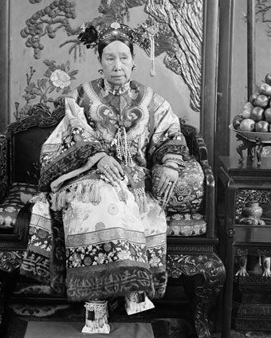
民法体系 – Civil Law System
1902 a translation of the German Civil Code (Bürgerliches Gesetzbuch) was presented to the Dowager Empress Cixi.

Slide 5
基本状况 Basic Advice
China has IP laws that meet international standards
Chinese courts do enforce IP rights, and particularly IP rights held by foreign parties
The PRC does have a “wild west” economy
To a large extent the threat to IP from counterfeiters can be costed and managed

Slide 6
在中国打官司- Going to Court in China
Enforcement of Contracts –
World Bank – www.doingbusiness.org/EconomyRankings
Based on procedures, time and cost
People’s Republic of China - 5th
United States – 16th
Russian Federation – 18th
Canada – 114th

Slide 7
前期工作 Getting Started
A. Survey the Existing Portfolio
Uniform client name in Chinese
Mixed ownership - - sometimes subsidiaries
Key trademarks missing
Patents missing
Existing Manufacturing Agreements
English only, including the name of the Chinese party
Use American laws and courts
No liquidated damage provisions
Ownership of IP rights and molds not clearly defined

Slide 8
前期工作 Getting Started
B. Survey the Market for Infringers
Check Alibaba in English
Check Alibaba and other sites in Chinese
Trade Shows
Client Reports

Slide 9
前期工作 Getting Started
C. Identify Legal Issues
OEM (original equipment manufacturer) Rule and other jurisdictions
Marks of Competitors
PRC Rules for the Collection of Evidence
Enforcement Options – courts, administrative action, AIC raids

Slide 10
前期工作 Getting Started
D. Recommendations
Correct existing trademark registrations
File more trademark registrations
Select infringers for enforcement
Investigate use of other IP rights

Slide 11
维权 - Enforcement
A. Due Diligence
Is the infringer an individual or a corporation
If a corporation, who is the 法定代表人?
Search the address in Chinese – is it valid
Is the infringer a factory or a re-seller/broker

Slide 12
维权 - Enforcement
B. Product and Rights Infringed
In what jurisdiction, in what PRC province?
What is infringed?
Trademarks – OEM Rule problem
Design patents – has the design been reviewed already by SIPO?
Copyright – can you chain the title according to the PRC Copyright Act
For Invention patents:
is it a product or a process patent?
what claim is infringed?
how is it evidenced in the product or in the factory?
Has the right been registered with PRC Customs

Slide 13
维权 - Enforcement
C. Options for Enforcement
Online takedown
AIC Raid – no damages, can be slow to act and miss evidence
Administrative Enforcement for Patents – no damages, but faster
Court – our preferred option

Slide 14
维权 - Enforcement
C. Options for Enforcement
Cease and desist letter – we use them rarely
Like Russia, in in the PRC there is no obligations on the infringer to produce evidence or documents
Letters can be a warning to infringers to hide the evidence
Can be used on lesser infringers, especially with successful court decisions

Slide 15
维权 - Enforcement
D. Winning Factors
Strategy –
Must be developed well before filing
Is very different from the strategies appropriate in U.S. or Canada
Evidence –
No discovery
Each party is responsible for collecting their own evidence
Generally the evidence should be notarized or otherwise authenticated
Best collected before the action is filed

Slide 16
维权 - Enforcement
E. Collecting Evidence
Done before filing the claim with the court
Online evidence should be collected by a notary in the PRC – there are very special procedures required
For physical evidence – first conduct an investigation to locate what is wanted
Then return with a notary to “do the buy” or accept the brochure etc. The notary will tape all this and retain the physical evidence to prepare a report for use in court

Slide 17
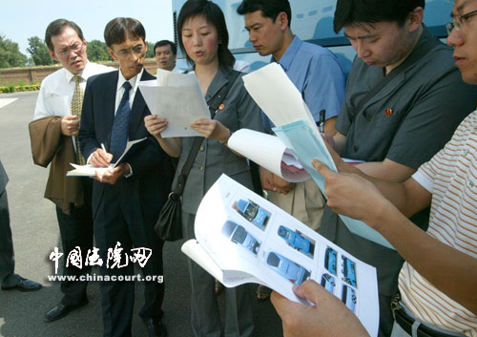
维权 - Enforcement

Slide 18
在中国打官司- Going to Court in China
F. Proceedings
File the statement of claim with some of the evidence
In about a week the court will decide on acceptance and serve the defendant
Initially the defendant will be given about a month to file its defense and evidence

Slide 19
在中国打官司- Going to Court in China
F. Proceedings
For domestic cases the decision is to be delivered within six months of the date of acceptance, or an explanation must be given to the Chief Judge of the court
Difficult cases are also considered by the Adjudicative Committee
Judges who hear the case may also mediate the case

Slide 20
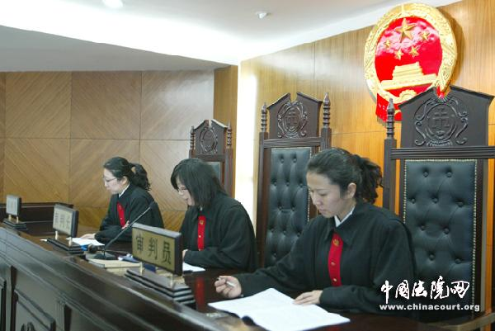
在中国打官司- Going to Court in China

Slide 21
结论 - Conclusion
China supports IP
IP rights are enforceable
Contracts are enforceable
Wild west economy
Greater due diligence needed
Government will intervene more in the “public interest”

Slide 22
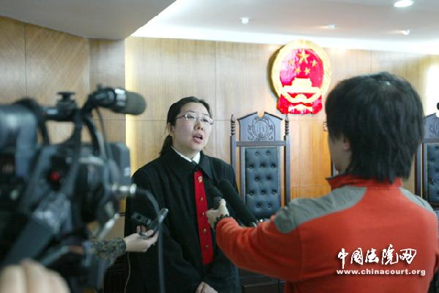
有问题吗？- Questions?

Slide 23
ЭФФЕКТИВНАЯ ЗАЩИТА ИНТЕЛЛЕКТУАЛЬНОЙ СОБСТВЕННОСТИ В КИТАЕ 如何在中国有效地保护知识产权 HOW TO EFFECTIVELY PROTECT IP IN CHINA
ПОЛ ДЖОУНС Paul Jones 钟保禄
www.jonesco-law.ca

